Slide 1

Regression Analysis Course Project
Insurance Premium Prediction
Guided By:
Monika Bhattacharjee
Assistant Professor, IIT Bombay

Slide 2
Problem Statement
Objective:
To build a MLRM that can accurately predict the Insurance Premium(charges) based on various predictors.
Goal: Understand the impact of various predictors (age, sex, BMI, smoking status, number of children, and region) on the monthly insurance charge.
Emphasis: Focus on model diagnostics and validation to draw robust conclusions about the relationship between these factors and insurance charges.

Slide 3
About the Dataset
The dataset, sourced from Kaggle, contains data on 1,338 individuals, collected randomly to ensure statistical relevance.
Features:
Age: Age of individuals (in years)
Sex: Gender of individuals (1 for male, 0 for female)
BMI: Body Mass Index (kg/m²)
Smoking Status: Smoking status (1 for smoker, 0 for non-smoker)
Number of Children: Number of children (0-5)
Region: Geographic region (northeast, northwest, southeast, southwest)
Monthly Insurance Charges: Monthly insurance charges paid (in rupees)

Slide 4
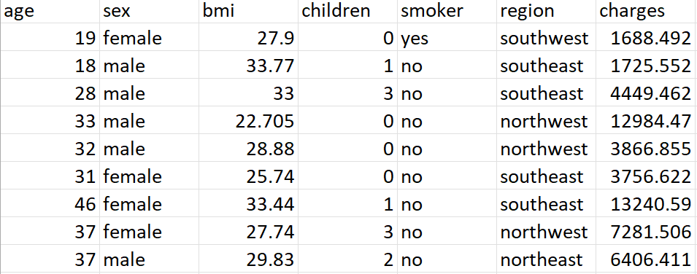
Glimpse of the Data

Slide 5
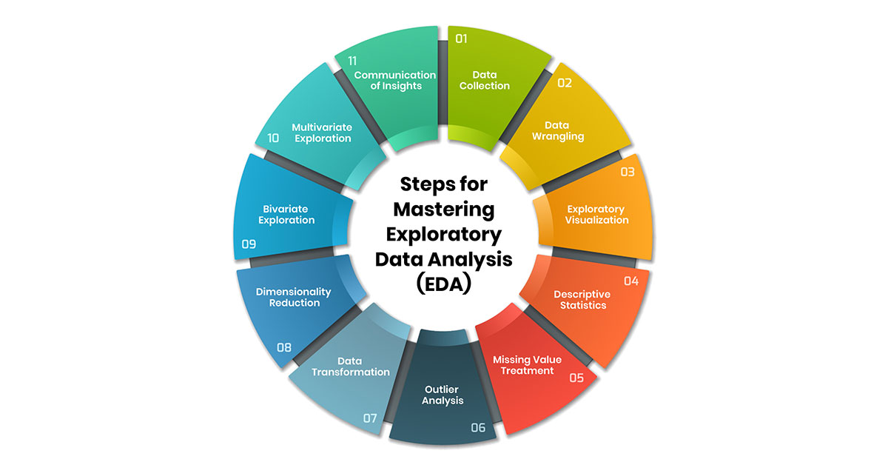
Exploratory Data Analysis (EDA)

Slide 6
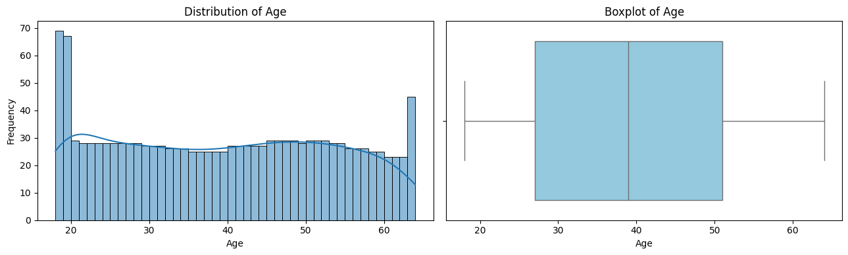
Univariate Data Analysis
Age

Slide 7
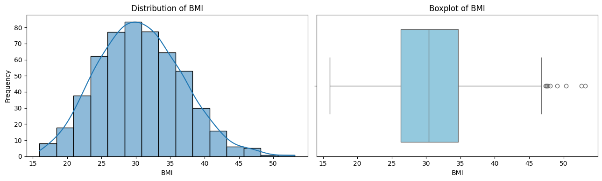
BMI

Slide 8
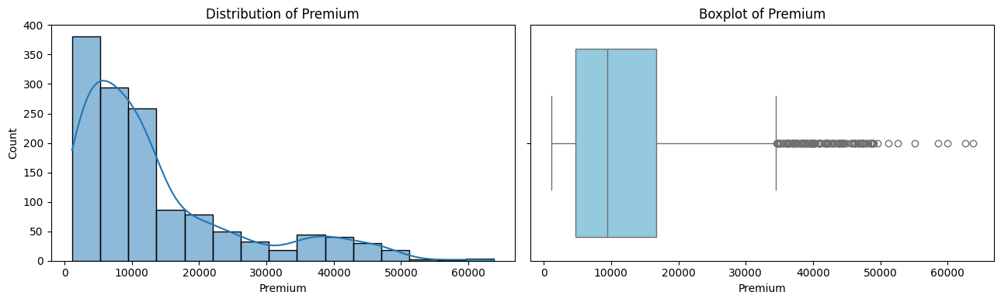
Charges

Slide 9
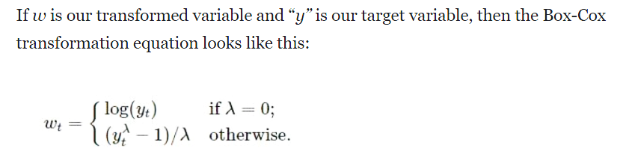
Box-Cox Transformation
The response variable is highly positively skewed with numerous outliers.We applied the Box-Cox transformation, aiming to make the response variable bell-shaped and symmetric.
The subsequent slide displays the transformed response variable using the Box-Cox method.

Slide 10
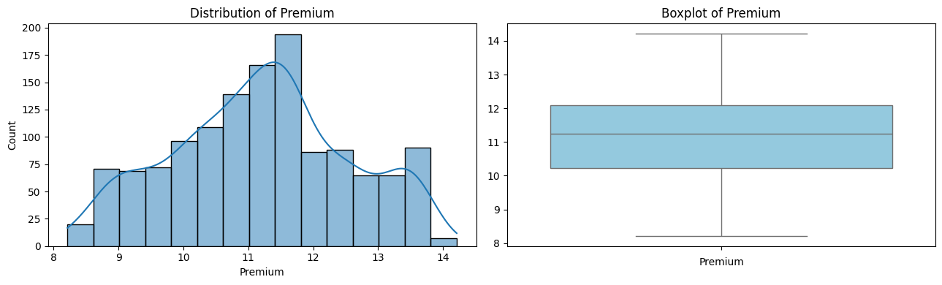
After using Box-Cox transformation we got transformed charges with approximately 0 skewness.

Slide 11
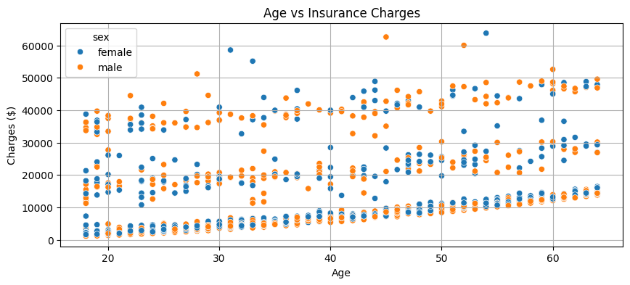
Bivariate Exploratory Data Analysis
Age vs Charges
The plot indicates a weak positive linear relationship between age and the response variable

Slide 12
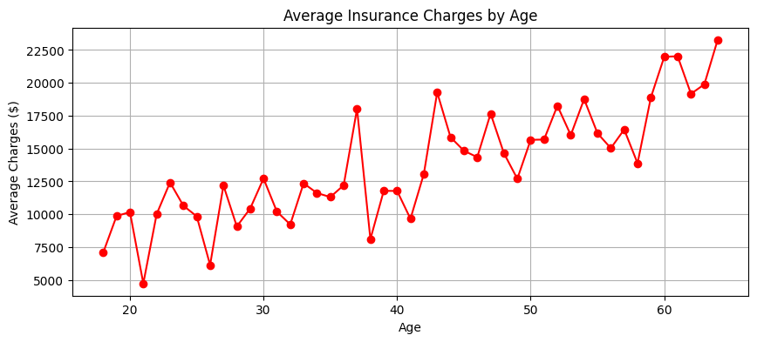
Average Premium vs Age

Slide 13
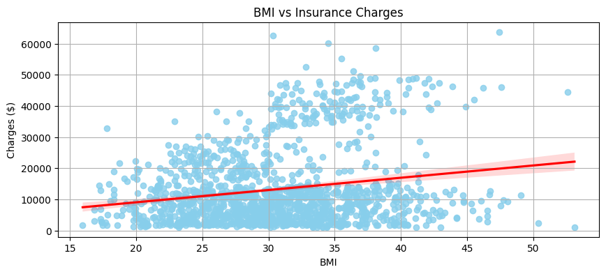
BMI vs Charges
The plot indicates a weak positive linear relationship between BMI and the response variable

Slide 14
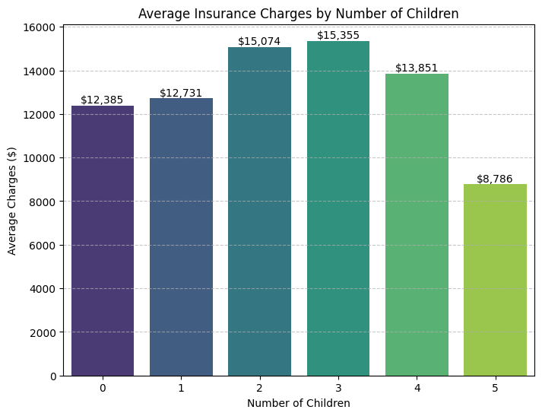
Number of children vs Charges

Slide 15
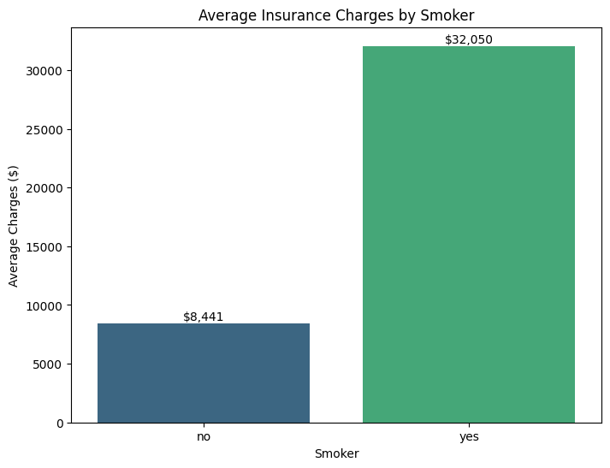
Smoker vs Charges

Slide 16
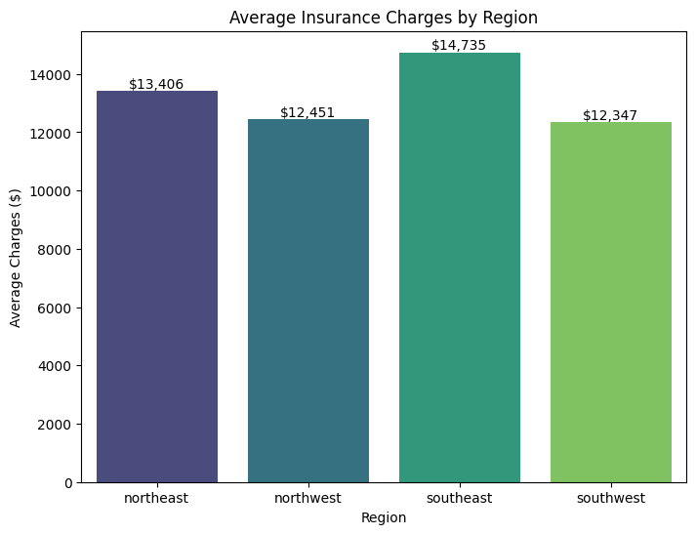
Region vs Charges

Slide 17
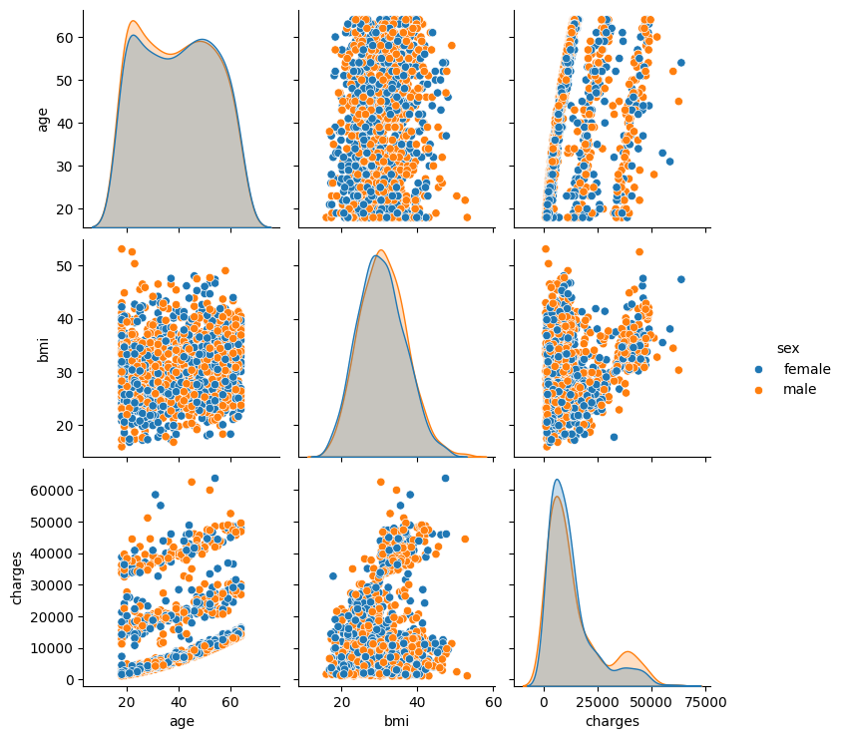
Pairplot

Slide 18
Pairplot Insights
The pairplot generated using Seaborn, visualizes the pairwise relationships between the variables age, BMI, and charges, with points colored by sex. This helps identify potential correlations, patterns, or group-wise differences across these variables. Diagonal plots show the distribution of each variable, while off-diagonal plots depict scatter plots between variable pairs, allowing for a quick visual inspection of linear or non-linear trends and how they may differ by gender.

Slide 19
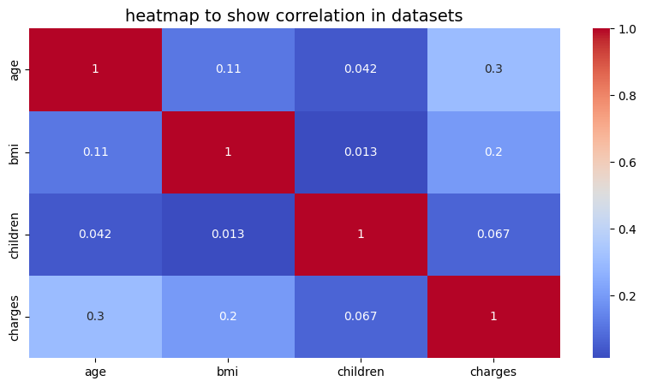
Heatmap

Slide 20
The highest correlation is between "age" and "charges" with a coefficient of 0.3, indicating a moderate positive linear relationship. As age increases, insurance charges tend to increase as well.
The correlation between "bmi" and "charges" is 0.2, showing a weak positive linear relationship. Higher BMI values are associated with significantly higher charges.
"Age" and "bmi" have a very weak correlation (0.11), suggesting that age does not strongly influence BMI in this dataset
"Children" and "charges" show a negligible correlation (0.067), implying that the number of children has almost no linear impact on insurance charges

Slide 21


Data Preprocessing
g

Slide 22
Handling Categorical Features
Discrete numerical values of ‘children’ column are grouped into 3 levels :
0 children : "No Children" (Baseline)
1,2 children : "Few Children"
>2 children : "Many Children’’
’sex’ is encoded as a binary variable, where 1 indicates male and 0 indicates female (baseline).
’region has 4 levels: Northeast (baseline), Northwest,Southeast, Southwest .
’smoker’ is also encoded as a binary variable, where 1 indicates smoker and 0 indicated non-smoker .
Then sex, smoker, region and new children column are one hot encoded and the baseline level for each variable is dropped to prevent multicollinearity, ensure meaning analysis and interpretation .

Slide 23
Handling Continuous Features
The numeric features (including the scaled response column) are standardized using StandardScaler from sklearn.
Standardization transforms numeric features to have a mean of 0 and a standard deviation of 1, which not only improves model performance but also allows for easier interpretation of regression coefficients by putting all features on a comparable scale.
Our final X contains scaled numeric features and one hot encoded categorical features, ready for modelling our final response column.

Slide 24
Model Building
Fitting the MLR model with transformed response and final predictors
Final predictors
The final predictors are given by : Age, BMI, sex_male, smoker_yes, region_northwest, region_southeast,region_southwest,children_category_few_children and children_category_many children
Final response
Transformed & scaled ‘charge’ variable

Slide 25
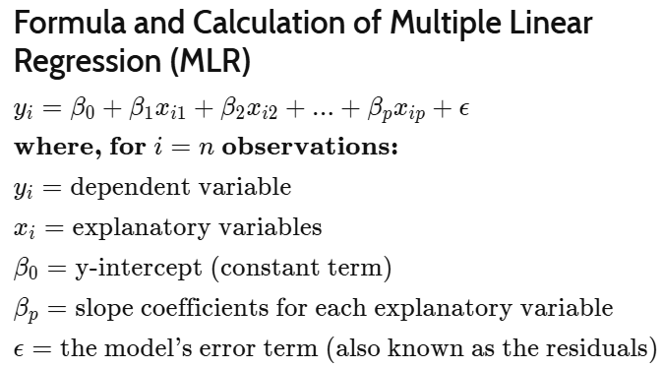
Model Description

Slide 26
Assumptions of MLRM
Linearity: The relationship between the independent variables and the dependent variable is linear.
Independence: The errors are independent. This implies no autocorrelation.
Homoscedasticity: The residuals have constant variance across all levels of the independent variables (i.e., no heteroscedasticity).
Normality of Errors: The errors are normally distributed. This is important for valid hypothesis testing and confidence intervals.
No Multicollinearity: The independent variables are not highly correlated with each other. High multicollinearity can inflate standard errors and make estimates unreliable.

Slide 27
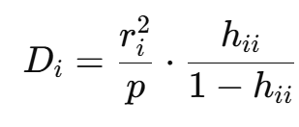

Initial Model Building
Initially fitted MLR model on entire data to assess the HAT Matrix for finding out Leverage Points(points having unusual X coordinate).
Found three Leverage Points, now proceeded for checking possible influential points in the entire dataset using Cook D.
Cook Distance :
Where is the studentized or Standardized residuals.

Slide 28


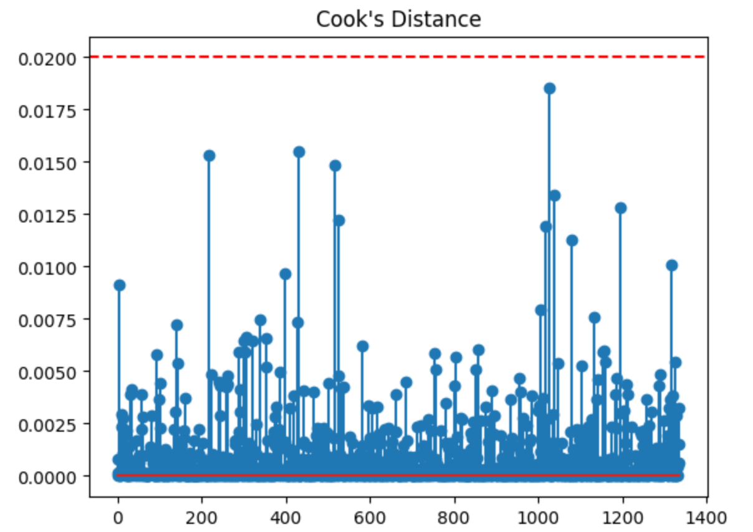
is the Leverage of observation i (from the Hat Matrix).
p is the number of parameters(including intercept).
Rule Of Thumb : We consider a point as influential point if >1
For the entire dataset we got all the < 0.02<<1 so no influential points.

Slide 29
The dataset is splitted into training (80%) and testing (20%) sets with a fixed random state for reproducibility.
A constant 1 vector is added to X_train to include the intercept in the regression model.
An OLS regression model is fitted using the training data.
The model is trained to minimize the sum of squared errors.
The key metrics are displayed like coefficients, R-squared, p-values, confidence intervals etc for model evaluation.

Slide 30
Also added a constant 1 vector to X_test to match the training model.
Predicted values (y_pred) are computed using the test set.
Residuals are calculated as the difference between actual and predicted values.
Evaluated model performance using:
MSE – average squared prediction error
RMSE – error in the same unit as the target
R-squared – variance explained by the model
Adjusted R-squared – accounts for number of predictors
These metrics indicate how well the model performs on unseen data.

Slide 31
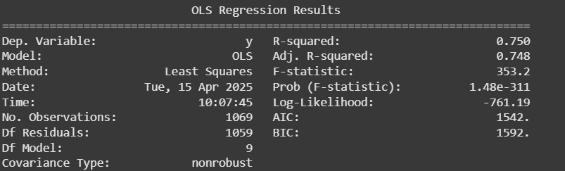
Performance on Train set

Slide 32
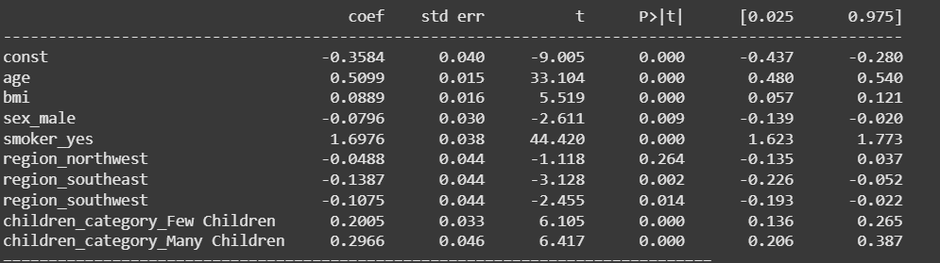
Fitted Model Parameters

Slide 33
10-Fold Cross Validation
Used 10-fold cross-validation to evaluate model stability across different data splits.
KFold ensures data is shuffled and splitted into 10 equal parts.
Computed R² scores for each fold to assess model performance.
Adjusted R² is calculated for each fold to account for number of predictors.
Printed R² scores, average R², and average Adjusted R² to summarize model performance.

Slide 34
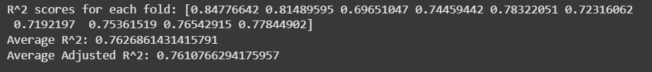
Performance on 10-fold Cross Validation
The average of adjusted R-squared came out to be 76% which validates the
consistent performance of the model.

Slide 35
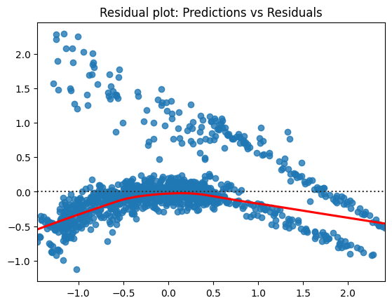
Residual Plot

Slide 36
Residual Plot Insights
The residuals should be randomly scattered around zero, without any clear pattern which ensures :
Linear relationship between the predictors and the response.
Homoscedasticity (constant variance of errors)
We got a curved pattern in the residual plot which indicates a non-linear relationship, between predictors and response variable, thus we cannot validate the assumptions of MLRM.

Slide 37
Stepping Towards Polynomial Regression
Now we perform multiple linear regression again but this time we use additional polynomial features ‘age^2’, ‘bmi^2’, interactions between ‘age’ and ‘bmi’, ‘age’ and ‘smoker’ & ‘bmi’ and ‘smoker’ .
Thus we have 14 predictors at hand to model the response variable.
We fit a multiple linear regression model (with intercept) on the entire data available and find Cook’s distances (for each 14-dimensional datapoint) to check for influential points, as done previously.

Slide 38
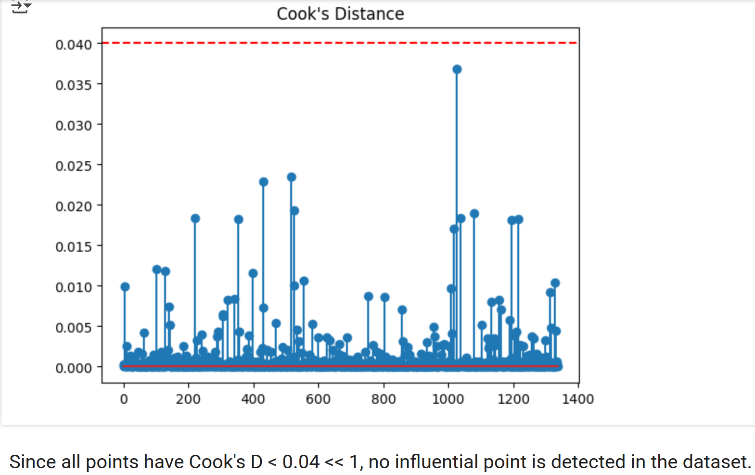
Inquiring for Influential Points

Slide 39
Training Polynomial Model
Now we train the new model and test its performance on the same train-test splits to ensure consistency of model improvement with additional features.
Now, we study the model’s performances on train and test sets respectively.

Slide 40
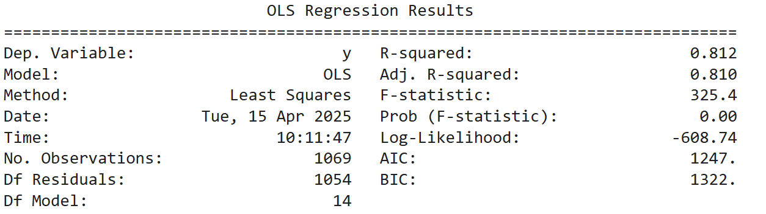
Performance on Train set

Slide 41
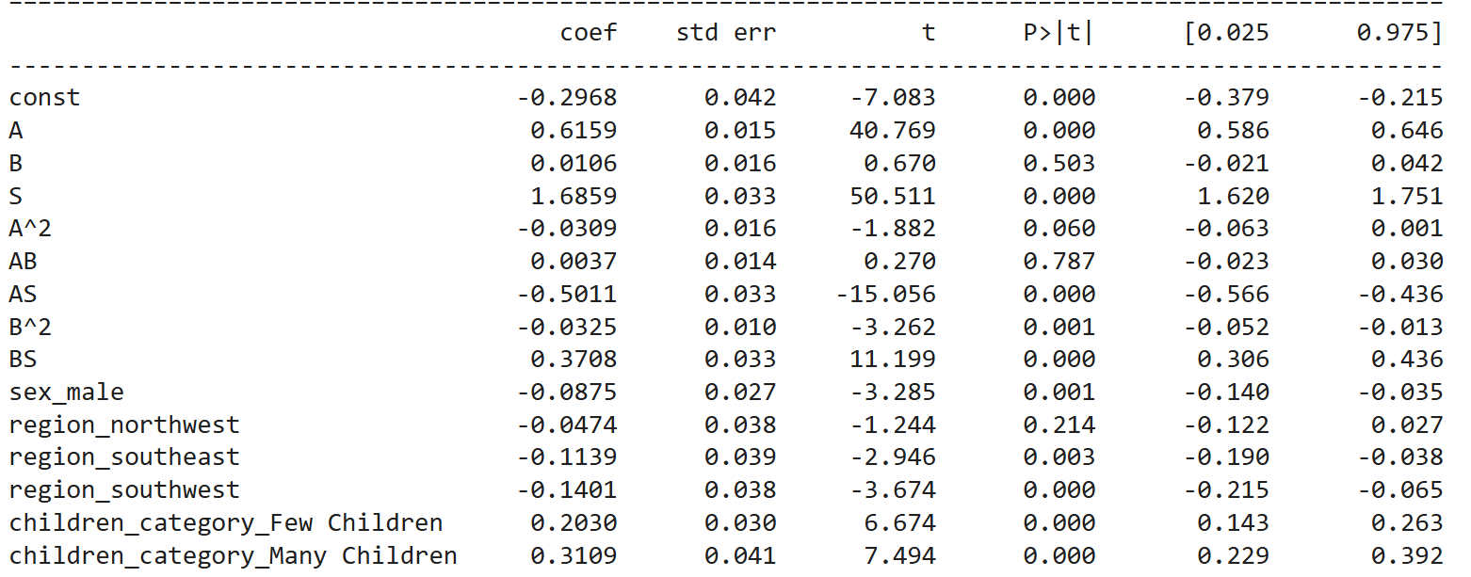
Model Parameters

Slide 42
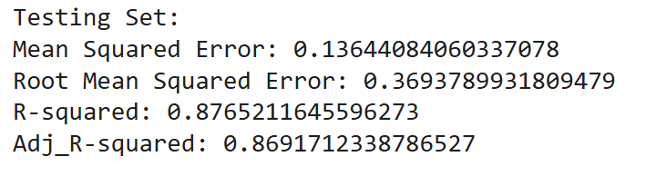
Performance on Test Set
The adjusted R-squared came out to be 87% which validates that
model performance is good for unseen data.

Slide 43
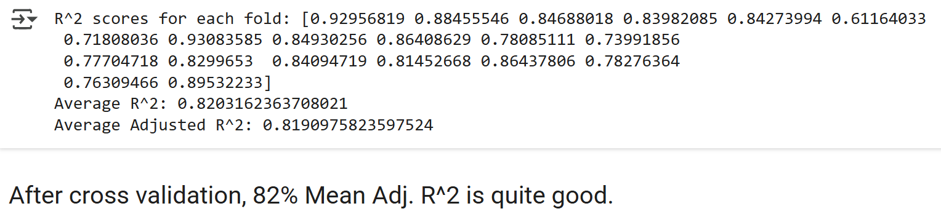
Performance on 20-fold Cross Validation
The average of adjusted R-squared came out to be 82% which validates the consistent performance of the model.

Slide 44
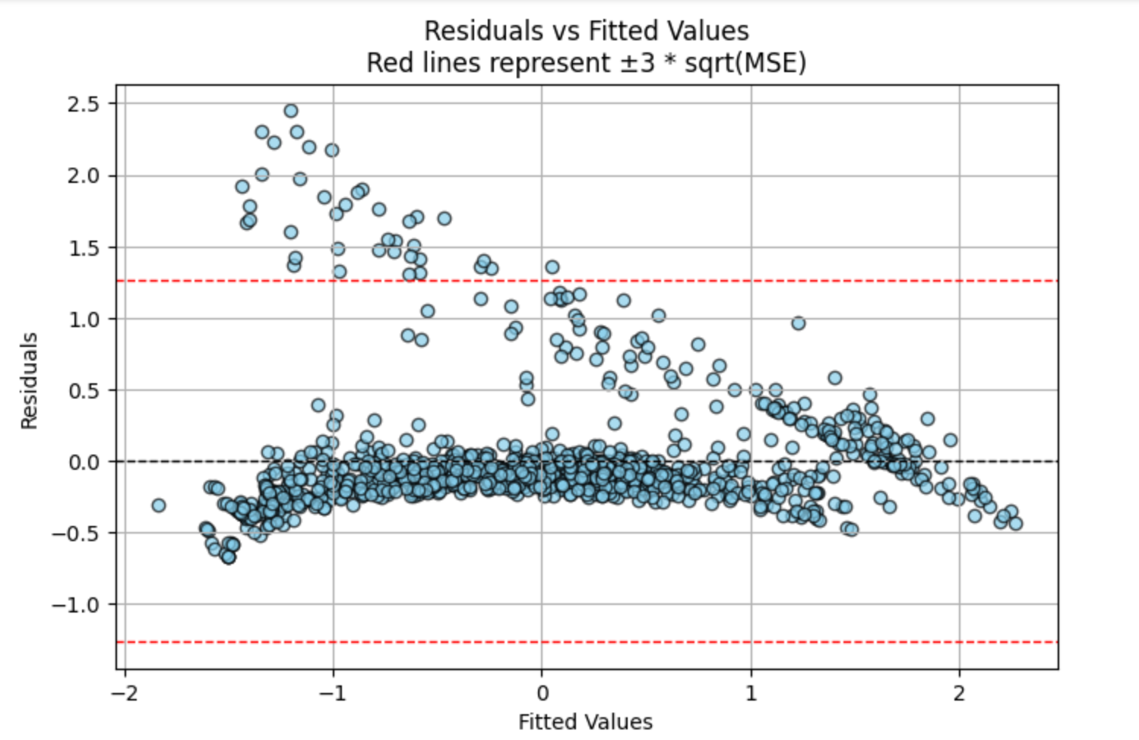
Residual Plot

Slide 45
Residual Plot Insights
The residuals should be randomly scattered around zero, without any clear pattern to validate :
Linear relationship between the predictors and the response.
Homoscedasticity (constant variance of errors)
We got a curved pattern in the residual plot which indicates a non-linear relationship, thus we cannot validate the assumptions of MLRM.
We do not have enough evidence to validate homoscedasticity and linearity even in the improved model.

Slide 46


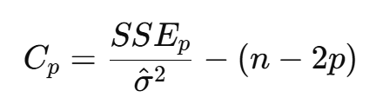

Best Model Selection
Used AIC,BIC and Mallows Cp for selection of best subset of predictors.
Formula:
Where k = number of parameters (including intercept),L = likelihood of the model,n = number of observations
​ = Sum of Squared Errors for the candidate model with p predictors

Slide 47

Finding the Best Model
Fitted all the possible models( models)and calculated the values of AIC,BIC and Mallows Cp.
Investigated the models having lowest AIC,BIC and Mallows Cp values.
BIC reduces the model complexity from 14 predictors to 10 predictors.
AIC and Mallows Cp reduces the model complexity from 14 predictors to 12 predictors.
Selected the model having 10 predictors as the final model.
Final predictors selected are:
age,bmi,smoker,bmi^2,interaction terms of smoker with age and bmi,sex_male,region_southeast,region_southwest,few_children and many_children.

Slide 48
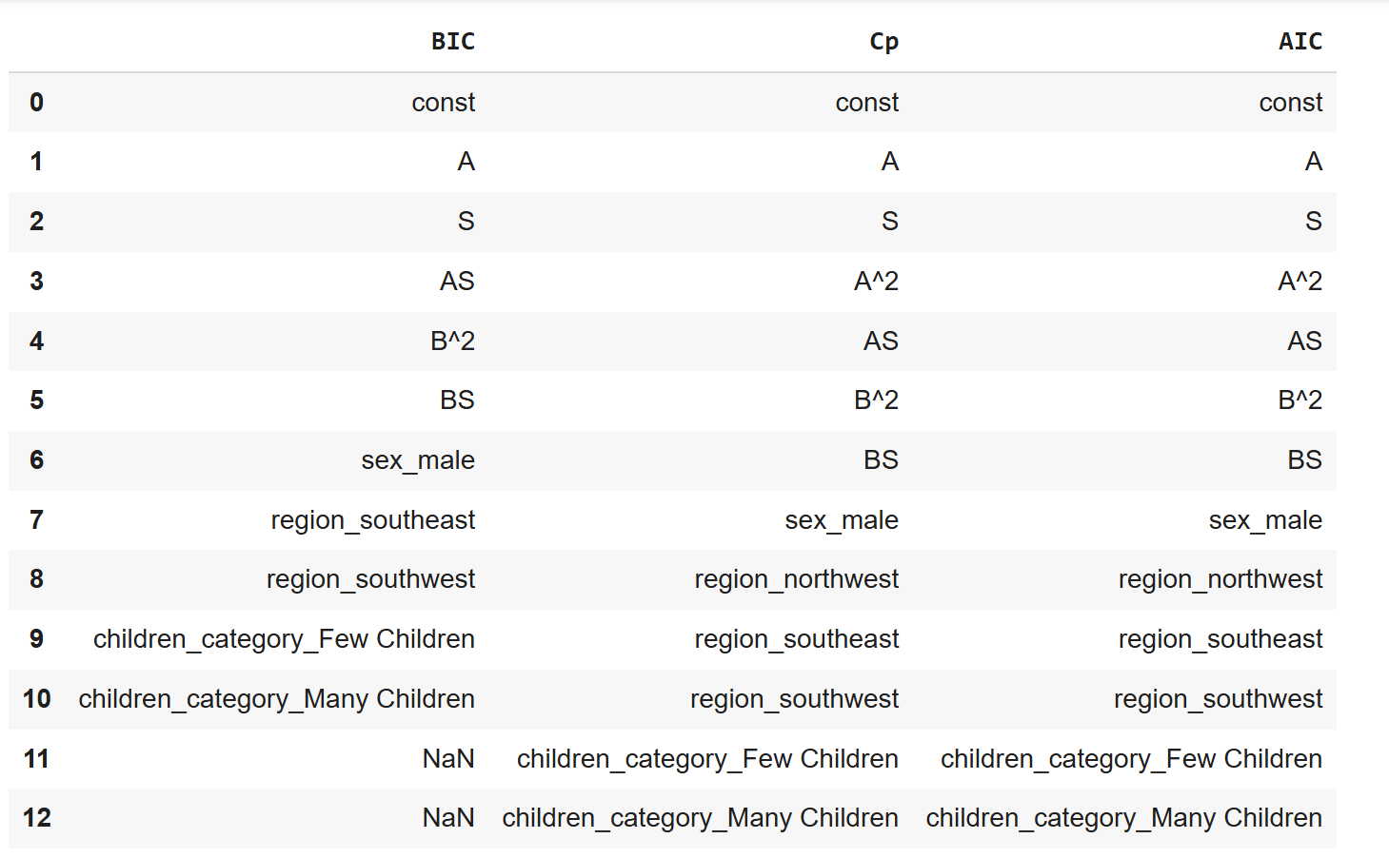
Predictors Selected by AIC,BIC & Mallow’s Cp

Slide 49
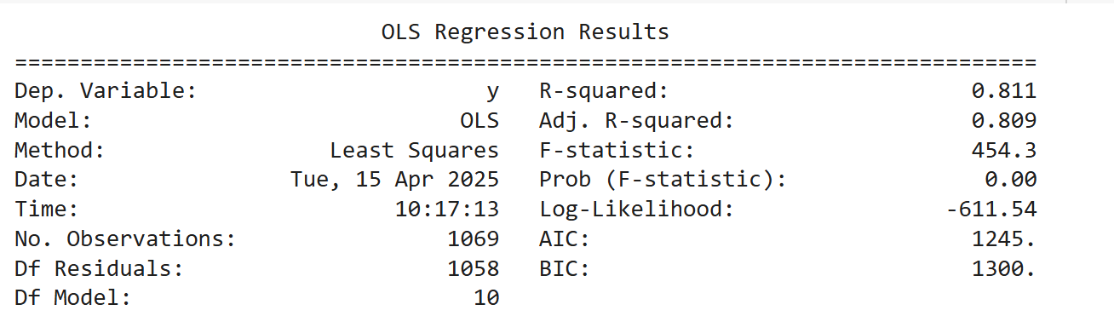
Fitting Best Model Obtained using BIC
We use the same train test split for fitting and evaluating model performance, but we use the 10 predictors selected using the mentioned criterion to account for tradeoff between model complexity and goodness of fit.
Model Performance on train set :

Slide 50
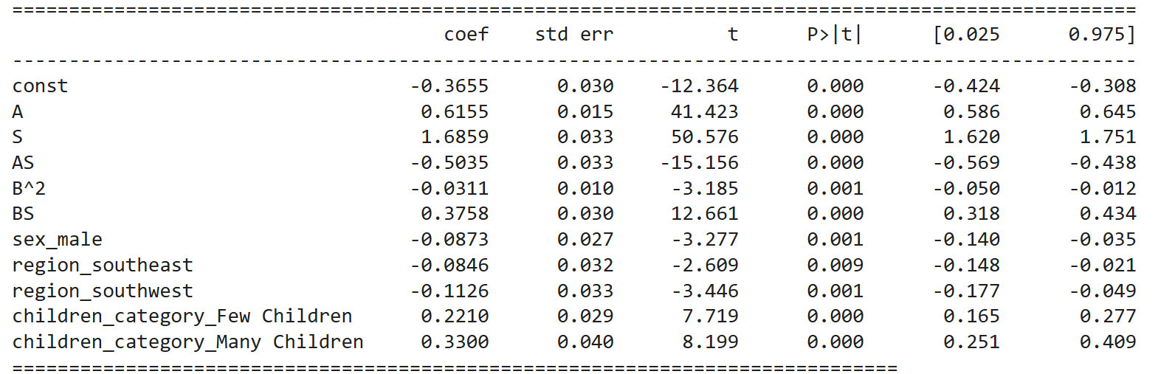
Final Model Parameters

Slide 51
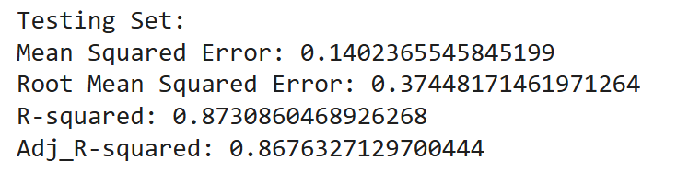
Performance of Final Model on Test Set
The adjusted R-squared came out to be 86% which validates that model is extremely good with unseen data.

Slide 52
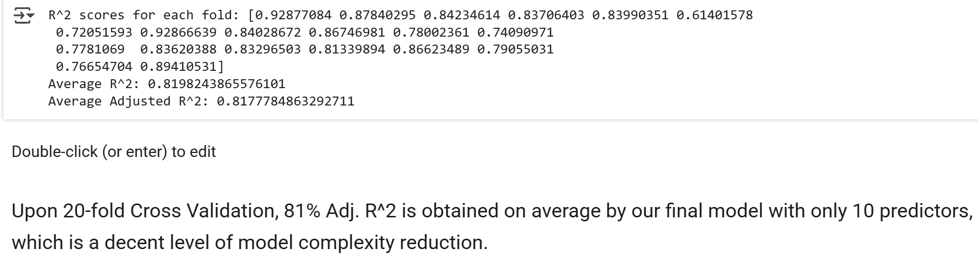
Performance of final model on 20-fold Cross Validation

Slide 53


Slide 54
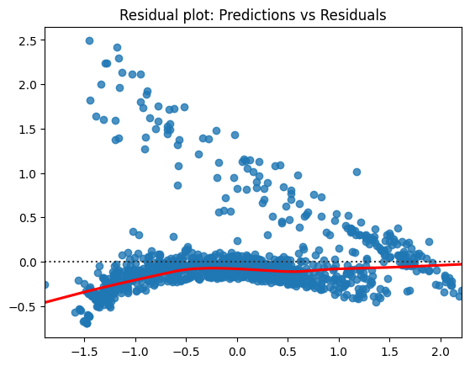
Linearity
The curve pattern in the residual vs fitted plot for our final model does not allow us to validate linear relationship between response and predictors and homoscedasticity of errors.

Slide 55
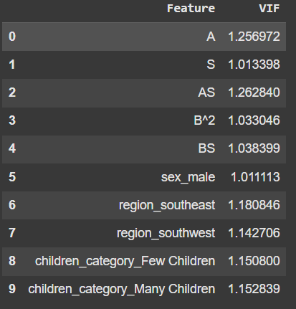
Multicollinearity
Since all VIF values of predictors in our final model is very small (<<5), we can conclude absence of multicollinearity in our final design matrix.

Slide 56
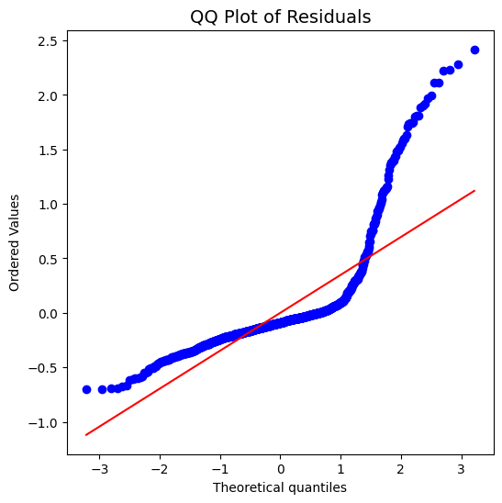
Normality of Errors
Shapiro Wilk Test yielded a p-value of approximately 8.28 × 10⁻¹⁵, which is significantly less than the typical significance level of 0.05.
Thus, we reject the null hypothesis that the residuals are normally distributed, indicating a violation of the normality assumption of errors in our model.

Slide 57
Independence of Errors & Homoscedasticity
Since value of Durbin-Watson Test Statistic comes out to be 1.9374 (close to 2) , we can accept the null hypothesis that errors are not autocorrelated.
P-value for the Breusch-Pagan test comes out to be 1.5289038546450486e-09 << 0.05 hence we reject the null hypothesis that errors are homoscedastic.

Slide 58
Conclusion
Our final Multiple Linear Regression model showed good predictive performance with a test set adj R² of 0.873 and RMSE of 0.3745. However, key assumptions like normality of errors and homoscedasticity were violated. Despite an average cross-validated R² of 0.82, these violations suggest that exploring advanced non-parametric methods may lead to more robust and reliable predictions.

Slide 59
Presented By:
Tathagat Pandey
Neha Bawdekar
Deepshikha Sarda
Siboham Pattanayak
Brian Wanzama
Jitesh Yadav

Slide 60


